Slide 1


Plan B
SACC Software Design
Explained by:
Greg Hovagim
Nathan Soule
Watched Quietly by:
Austin Dionne
Carlos Lazo

Slide 2
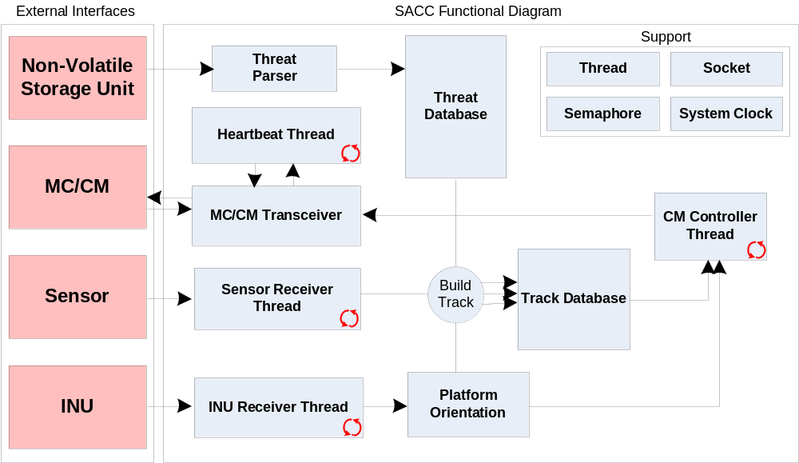
Block Diagram

Slide 3
Use Cases

Slide 4
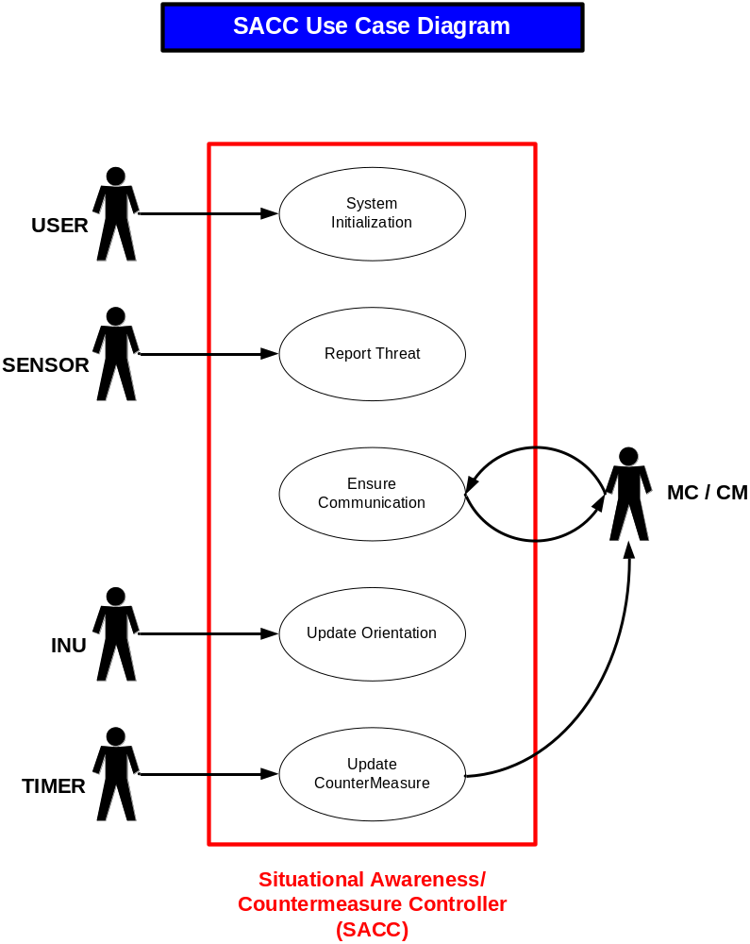

Slide 5
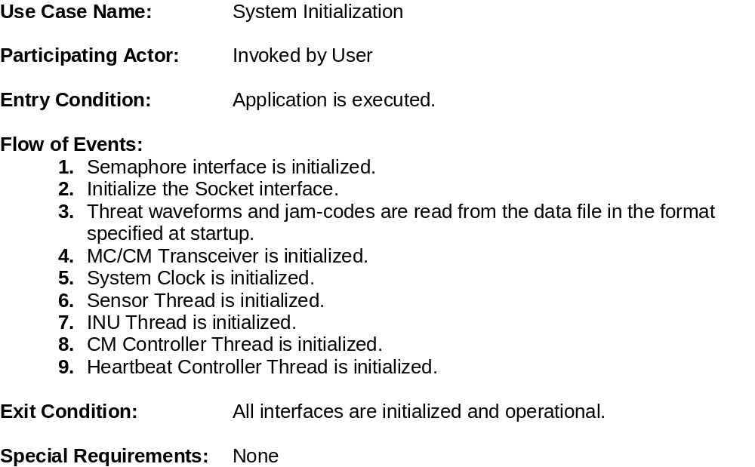
Use Case Scenario 1

Slide 6
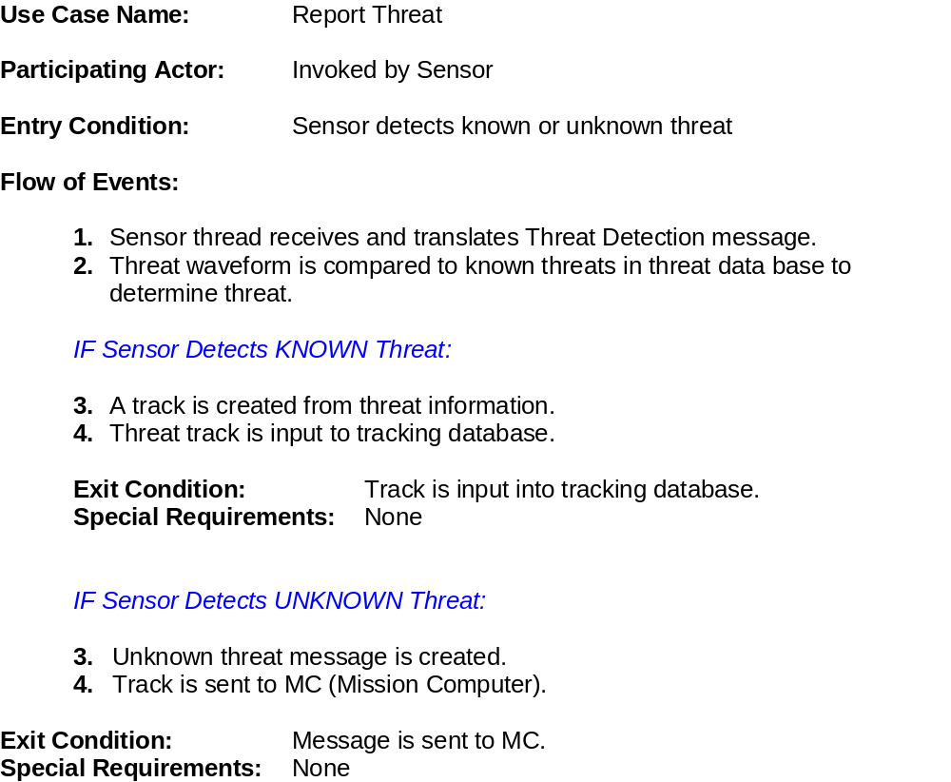
Use Case Scenario 2

Slide 7
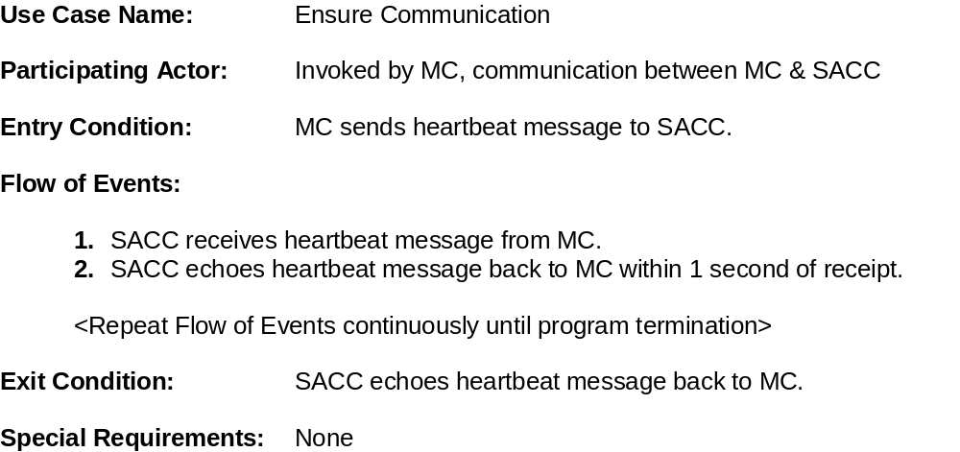
Use Case Scenario 3

Slide 8
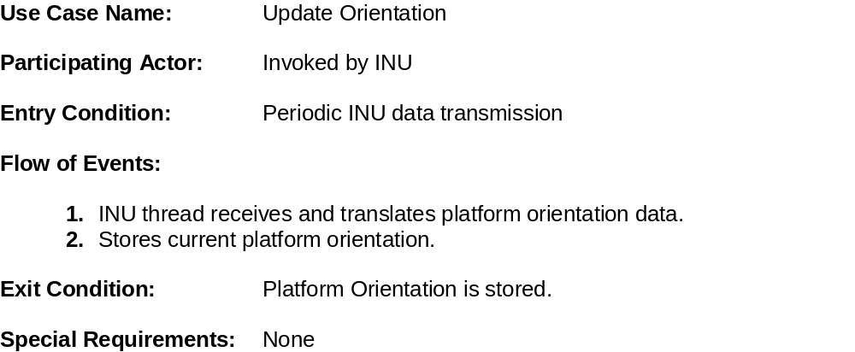
Use Case Scenario 4

Slide 9
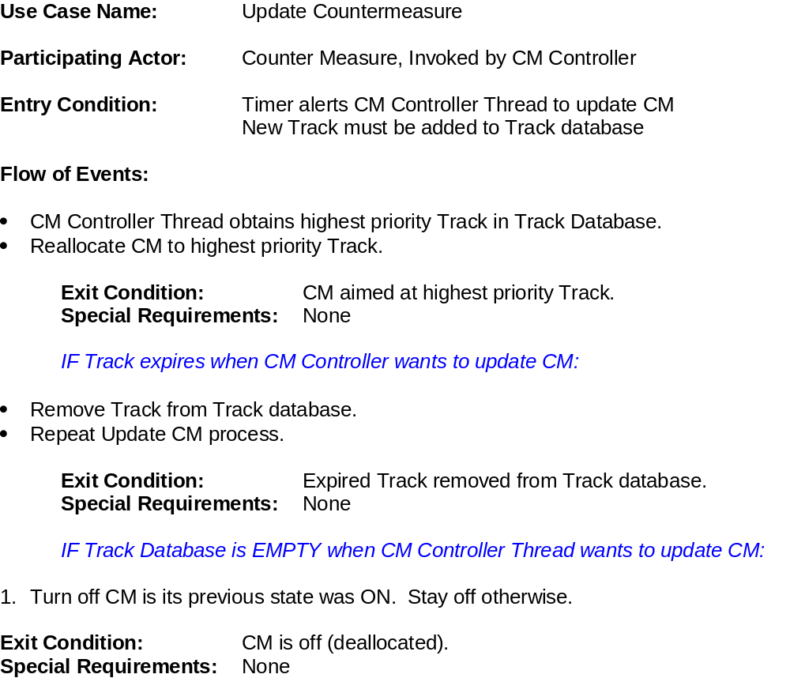
Use Case Scenario 5

Slide 10
UML

Slide 11
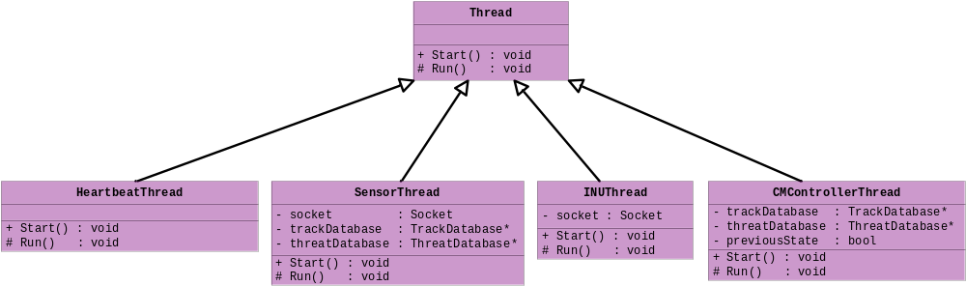
Thread Classes
Implements Abstract Design Pattern

Slide 12
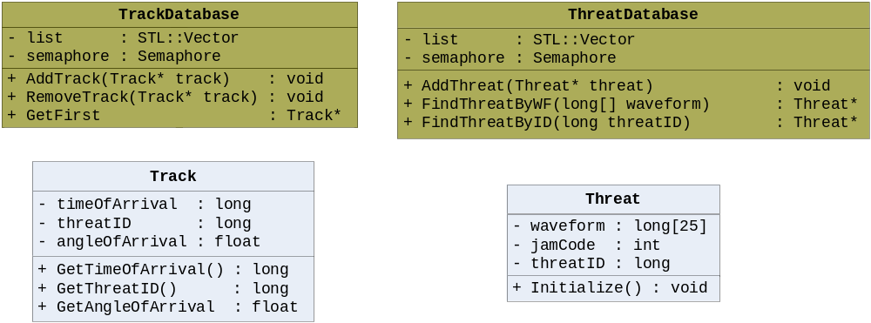
Database Classes
Implements Adapter Design Pattern

Slide 13
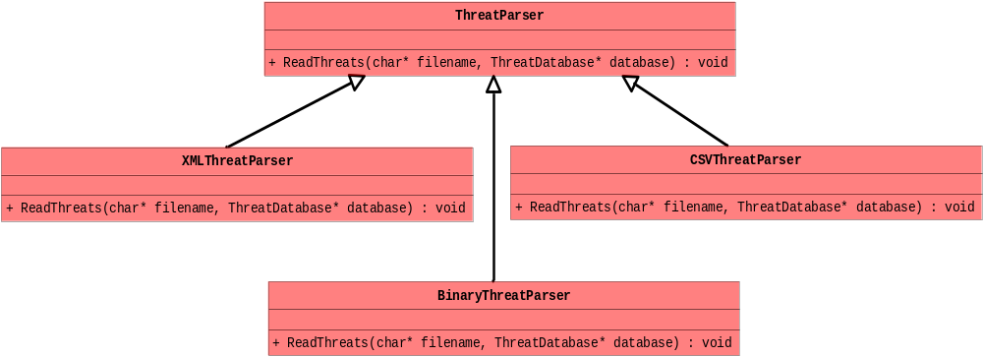
Parser Classes
Implements Abstract Factory Design Pattern

Slide 14
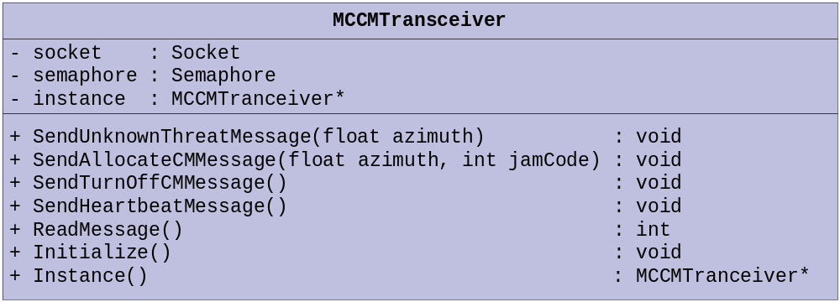
Shared Socket Class
Implements Singleton Design Pattern

Slide 15
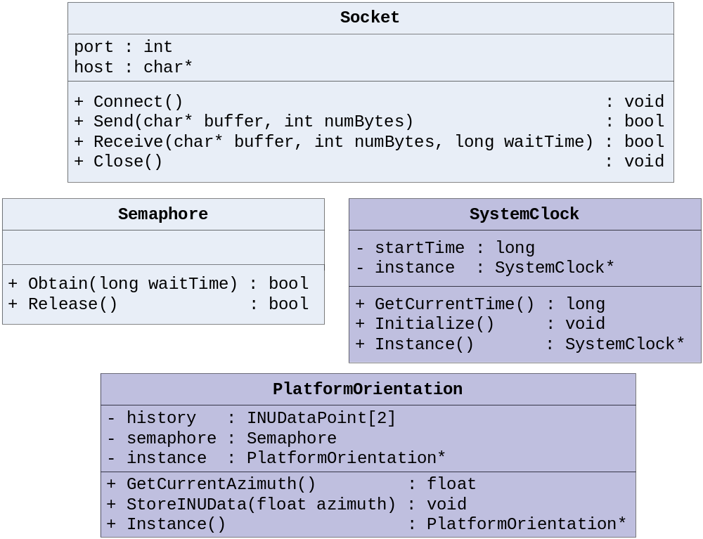
Utility Classes
Implements Singleton Design Pattern

Slide 16
Sequence Diagrams

Slide 17
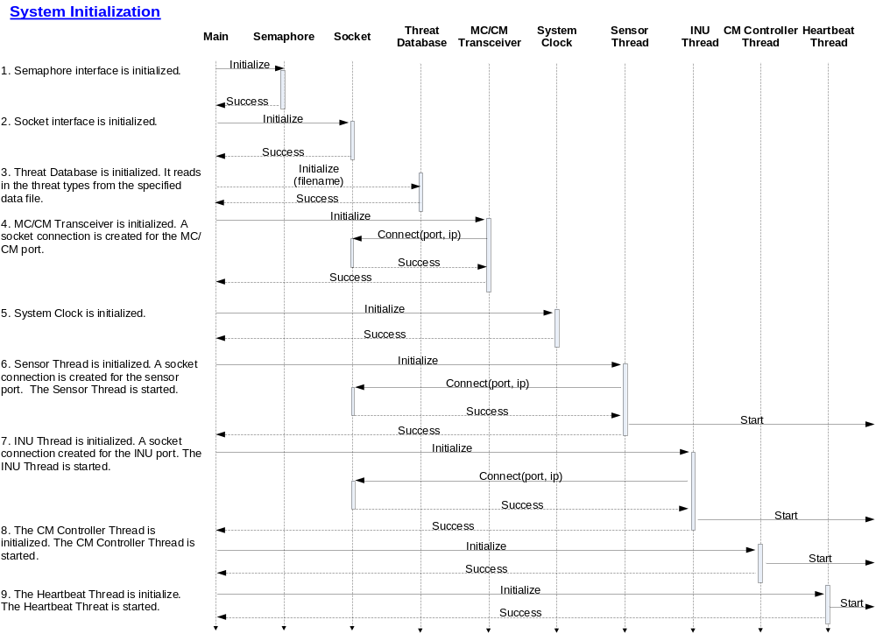

Slide 18
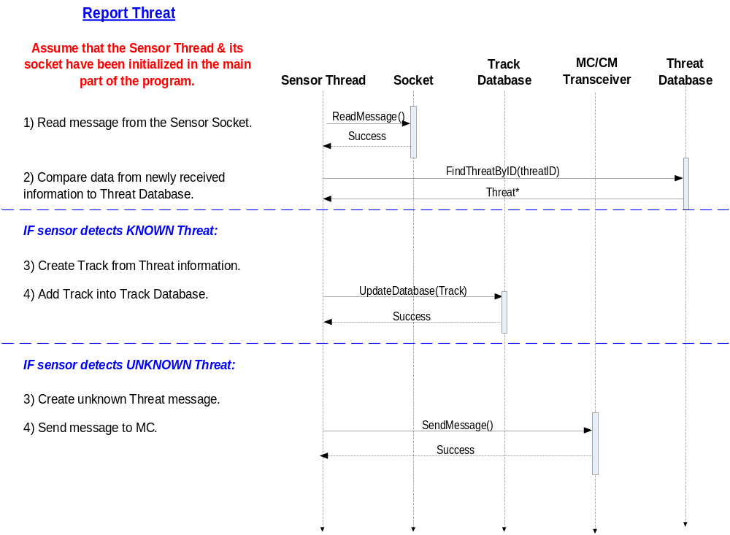

Slide 19
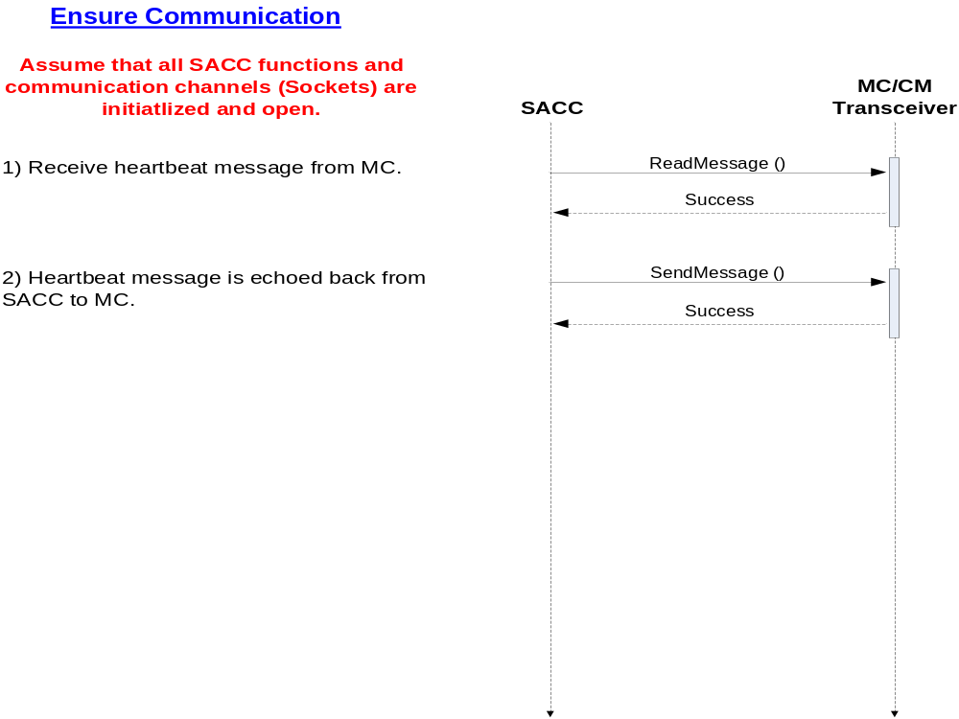

Slide 20
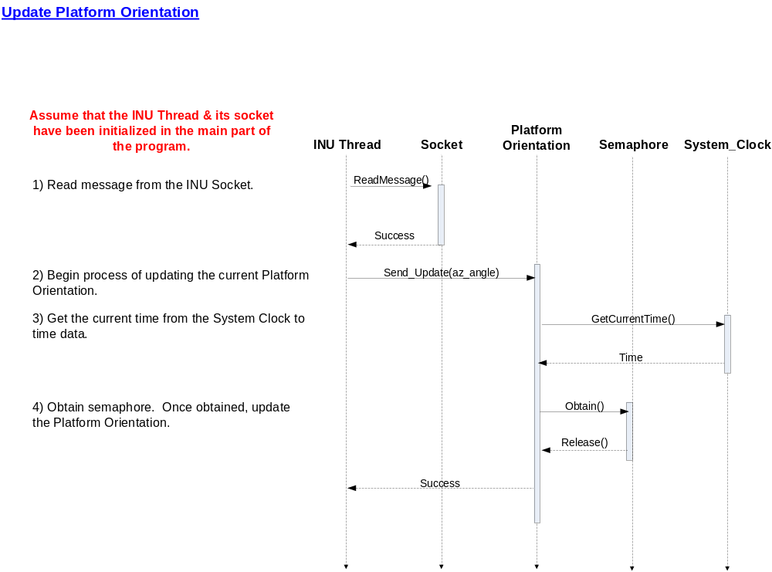

Slide 21
